Slide 1



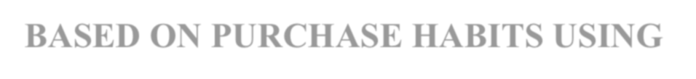



K.RAMAKRISHNAN COLLEGE OF TECHNOLOGY
(AUTONOMOUS), TRICHY
GROUPING SIMILAR CUSTOMERS BASED ON PURCHASE HABITS USING K-MEANS
PRESENTED BY SANTHIYA S-ADB23096

Slide 2
PRESENTATION OVERVIEW
Problem Identification
Objective
Proposed system
Block diagram of proposed system
R Library
Modules
Implementation
Output
Conclusion
Advantages of proposed system

Slide 3
PROBLEM IDENTIFICATION
Customer segmentation plays a crucial role in business decision-making. Businesses need to identify groups of customers with similar purchasing habits to improve marketing strategies, personalize services, and increase customer satisfaction.
Manual analysis is time-consuming, so clustering techniques like K-Means can automate this process.
K-Means clustering is one of the most commonly used unsupervised learning
algorithms for customer segmentation.
2/7/20

Slide 4
OBJECTIVE
The primary objective is to group customers based on their purchasing behavior (e.g., spending amount, purchase frequency).
This enables businesses to understand distinct customer segments, which can be targeted with more personalized marketing strategies, promotions, or product recommendations.
The project aims to automate and support decision-making by providing
insights into customer behavior.
By leveraging customer segmentation, businesses can make more informed decisions about resource allocation, product offerings, and retention strategies, ultimately improving customer satisfaction and business performance.

Slide 5
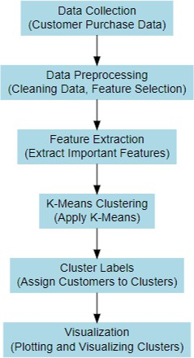
PROPOSED SYSTEM
BLOCK DIAGRAM

Slide 6
R Library USED
shiny:
Use Case: Used to create the interactive web application. It handles the user interface (UI) and server-side logic, enabling reactive behavior (e.g., updating the UI when users change inputs).
ggplot2:
Use Case: Used for creating visualizations, specifically for plotting the customer segmentation results after clustering. It helps generate the cluster visualization in the app.

Slide 7
R Library USED
factoextra:
Use Case: Used to visualize the results of the K-Means clustering in an easy-to-
understand scatter plot, with the clusters displayed using different colors and optional
convex ellipses around them.
dplyr:
Use Case: Used for data manipulation tasks such as summarizing the customer data by clusters and calculating the average spending on different categories for each
cluster.

Slide 8
LIST OF MODULE
generate_data()
fviz_cluster()
group_by() + summarise()
observeEvent()

Slide 9
MODULE DESCRIPTION
Module1: generate_data()
Use Case: Generates a sample customer dataset with random purchase values across categories (Groceries, Electronics, Clothing, Cosmetics).
Module2: fviz_cluster()
Library Used: factoextra
Use Case: Visualizes the clustering results, showing customers grouped by their purchasing patterns in a plot.

Slide 10
MODULE DESCRIPTION
Module3:group_by() + summarise()
Library Used: dplyr
Description:These modules are used to summarize the data by clusters. They calculate average spending in each category for every cluster, helping understand the characteristics of each customer group.
Module4:observeEvent()
Library Used: shiny
Description:This module listens for user interaction (button click) and
triggers the K-Means clustering process when the "Run Clustering" button is pressed.

Slide 11
IMPLEMENTATION
library(shiny)
library(ggplot2)
library(factoextra)
library(dplyr)
generate_data <- function(n = 100) {
set.seed(123)
data.frame(
CustomerID = 1:n,
Groceries = runif(n, 100, 1000),
Electronics = runif(n, 50, 2000),
Clothing = runif(n, 20, 800),
Cosmetics = runif(n, 10, 300))}
ui <- fluidPage(
titlePanel("Customer Segmentation Using K-Means"),
sidebarLayout(
sidebarPanel(
sliderInput("k", "Select Number of Clusters (K):", min = 2, max = 10, value = 3),
actionButton("run", "Run Clustering")),

Slide 12
IMPLEMENTATION
mainPanel(
plotOutput("clusterPlot"),
tableOutput("clusterSummary") ) ))
server <- function(input, output) {
data <- reactiveVal(generate_data())
observeEvent(input$run, {
df <- data()
df_numeric <- df[, sapply(df, is.numeric)] # This will select only numeric columns
df_scaled <- scale(df_numeric)
set.seed(123)
km <- kmeans(df_scaled, centers = input$k, nstart = 25)
df$Cluster <- as.factor(km$cluster)
data(df) })
output$clusterPlot <- renderPlot({
req(data()$Cluster)
df <- data()

Slide 13
IMPLEMENTATION
df_numeric <- df[, sapply(df, is.numeric)] # This will select only numeric columns
df_scaled <- scale(df_numeric)
km <- kmeans(df_scaled, centers = input$k, nstart = 25)
fviz_cluster(km, data = df_scaled,
palette = "jco",
geom = "point",
ellipse.type = "convex",
ggtheme = theme_minimal())})
output$clusterSummary <- renderTable({
req(data()$Cluster)
data() %>%
group_by(Cluster) %>%
summarise(across(Groceries:Cosmetics, mean, .names = "avg_{.col}")) })}
shinyApp(ui = ui, server = server)

Slide 14
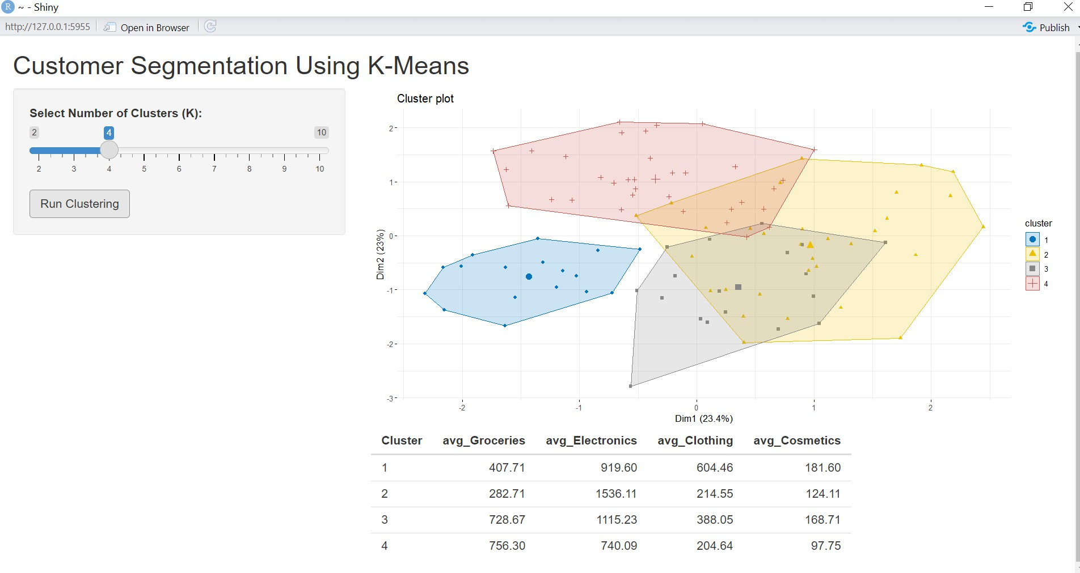
OUTPUT:

Slide 15
CONCLUSION:
This project uses K-Means clustering to segment customers based on their purchase habits. The Shiny app allows users to interactively select the number of clusters and visualize the results. Key functions like kmeans(), fviz_cluster(), and dplyr help group, visualize, and summarize customer data.

Slide 16
ADVANTAGES OF PROPOSED SYSTEM
Advantages of the Proposed System:
Improved Customer Targeting:
By grouping customers with similar purchasing behaviors, businesses can tailor their marketing campaigns and product offerings to each segment.
This allows for more personalized and targeted marketing, increasing the likelihood of engaging customers and improving conversion rates.
Visualization of Customer Insights:
The system can also generate visualizations, such as cluster plots, that help stakeholders easily interpret the segmentation results.
This visualization makes it easier for business owners and marketing teams to understand and communicate customer behavior patterns.

Slide 17


